Slide 1
Solving Network Problems
Chapter 13

Slide 2
Learning Objectives
Discuss benefits of network management and planning
Understand necessity for networking standards, policies and procedures, and documentation
Troubleshoot your network with a structured approach
Discuss types of specialized equipment and other resources available for troubleshooting

Slide 3
Preventing Problems with Network-Management and Planning
Two ways to solve networking problems:
Prevent them through planning and management
Called pre-emptive troubleshooting or trouble avoidance
Repair and control damage that already exists
Called troubleshooting

Slide 4
Preventing Problems with Network-Management and Planning
Combine network management and troubleshooting to form overall network plan
Include cable diagrams, cable layers, network capacity information, protocols and network standards, documentation on computer and network device configuration, software, and important files
Establish network policies and procedures
Include back-up methods, security, hardware and software standards, upgrade guidelines, and documentation

Slide 5
Backing Up Network Data
To prevent data loss, develop comprehensive back-up program, including
What data should be backed up and how often?
What type of backup will be performed, how often, and what time?
Who is responsible for performing backups?
Is backup system been tested regularly?
Is backup log complete?
Where is backed-up data stored (on-site and off- site)?
Table 13-1 shows several back-up methods

Slide 6
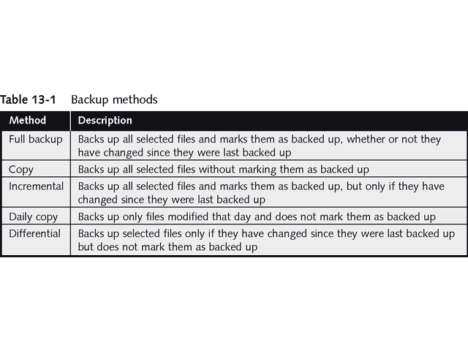
Backup Methods

Slide 7
Setting Security Policies
Security policies are part of network plan
Include both data and hardware security
Primary data security is username and passwords for all accounts, including
How often users change passwords
Whether users can reuse same passwords
What character restrictions passwords have
Whether passwords have single or multiple sets of standards
How exceptions are defined and documented

Slide 8
Setting Security Policies
Establish guidelines for resource access
Grant access only to users who require it
Grant minimum levels of access
Set special security requirements for dial-in accounts
Keep to a minimum the number of users who perform network administration tasks

Slide 9
Setting Hardware and Software Standards
Set standards for all network components
Determine supported hardware manufacturers and operating systems, including versions
Determine what networking protocols and services will be used
Define server configurations and guidelines for new server installations
Evaluate standards at least once per quarter to keep network up to date

Slide 10
Establishing Upgrade Guidelines
Establish guidelines for upgrades
Give users advance notice of changes
Try not to perform upgrades during working hours
First “pilot” upgrades with small group of astute network users to resolve problems
Have plan to undo upgrade installation if necessary

Slide 11
Maintaining Documentation
Keep complete up-to-date documentation of network, both in hard copy and in electronic form, including
Address list
Cable map
Contact list
Equipment list
Network history
Network map
Network hardware configuration
Policies and procedures
Server configuration
Software configuration
Software Licensing
User administration

Slide 12
Performing Pre-emptive Troubleshooting
International Organization for Standardization (ISO) identifies five categories for pre-emptive network troubleshooting:
Account management
Configuration management
Fault management
Performance management
Security management

Slide 13
Practicing Good Customer-Relation Skills
Users are customers, and the reason network personnel have jobs
Best source of information when something goes wrong with network
Develop special relationships with adept users
Develop guidelines about user interaction
Include how to question and respond to users, handle irate users, and general user communication etiquette

Slide 14
Using Network-Monitoring Utilities
Many programs help with network management
Identify conditions that may lead to problems, prevent network failures, and troubleshoot problems
Use network management utilities
Learn which statistics to monitor
Establish baseline for network performance
Monitor changes

Slide 15
Using Network-Monitoring Utilities
Use network management utilities in advanced operating systems or from third-party sources
Gather information about
Events
System usage statistics
System performance statistics

Slide 16
Using Network-Monitoring Utilities
Use information from utilities to help
Identify network devices that create bottlenecks
Provide information to forecast growth and plan capacity requirements
Develop plans to improve network performance
Monitor events that arise from software or hardware changes
Monitor trends in network traffic and utilization
Figure 13-1 shows Windows 2000 Performance Monitor

Slide 17
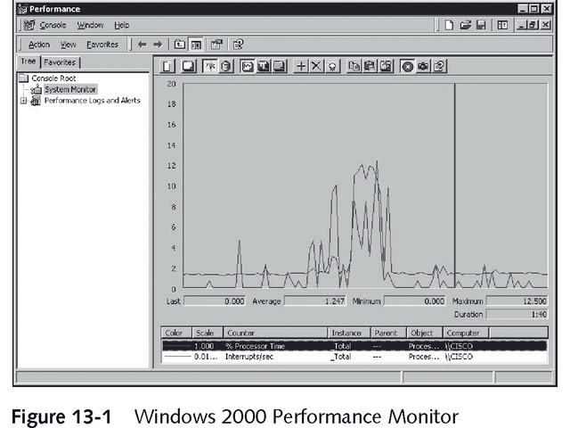
Windows 2000 Performance Monitor

Slide 18
Creating a Network Baseline
Defines point of reference for measuring network performance when problem occurs
Create baseline over time when no problems are evident on network and repeat baseline periodically, especially after significant changes to network
Compare network performance with baseline to help identify
Daily network utilization patterns
Possible network bottlenecks
Heavy usage patterns
Protocol traffic patterns

Slide 19
Monitoring with SNMP
Simple Network Management Protocol (SNMP) is part of TCP/IP protocol suite
Software agents for each network device monitors traffic and device status
Stores information in management information base (MIB)
See Figure 13-2

Slide 20
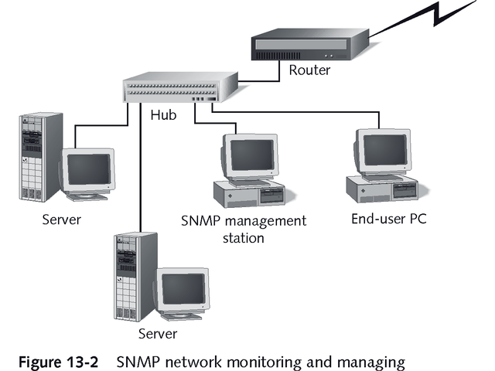
SNMP Network Monitoring and Managing

Slide 21
Monitoring with SNMP
SNMP monitors agents and collects data in MIBs to generate statistics or charts about network
Can set thresholds for SNMP managers
Generate alerts when thresholds are exceeded
Manage network components such as bridges and routers
Can interrogate devices and make remote configuration changes

Slide 22
Using Remote Monitoring (RMON) for Advanced Monitoring
Two versions of RMON:
RMON1 captures data and collects statistics at Data Link and Physical layers
RMON2 collects and analyzes traffic at Network and higher layers
Some devices are RMON-capable
Contain software agents, called probes, that collect data and communicate with management station using SNMP

Slide 23
Network Troubleshooting
In spite of planning, monitoring, and other pre-emptive techniques, problems do occur
Be ready to troubleshoot network to diagnose and fix problems, by using
Troubleshooting methodology
Structured approach
Special tools

Slide 24
Troubleshooting Methodology
Stay calm and use clear head to assess problems
Steps to help troubleshoot common network problems include
Eliminate potential user errors
Verify physical connections are working
Verify status of any suspect NICs
Restart computer

Slide 25
Structured Approach
Five-step structured troubleshooting approach for tackling complex network problems:
Set problem’s priority
Collect information about problem
Develop list of possible causes
Test each hypothesis to isolate actual cause
For each potential cause, attempt at least one solution

Slide 26
Prioritize
Determine scope of problem
Does it affect single computer or more
If multiple problems, assign each a priority
Tackle them in decreasing order of severity, starting with most severe problem

Slide 27
Collect Information
Ask user specific questions to obtain details
Scan network for obvious problems or failures
Review previous network problems to determine if problem is recurrent
Determine scope of problem by dividing network into small parts and checking each
Create troubleshooting checklist to make task more manageable

Slide 28
Establish Possible Causes
Create list of possible causes
Rank them in order of likelihood
Start with most likely cause

Slide 29
Isolate the Problem
Make only one change at a time and test it
Be sure changes do not introduce new problem
Document all hardware, software, or configuration changes

Slide 30
Test Results
After each change, test results to see if problem is fixed or new problem is introduced
When problem is solved, document steps that implemented solution
Include information in network documentation
If change does not fix problem, move to next possible cause
Sometimes a change reveals another deeper problem

Slide 31
Using Special Tools
Most problems occur at lower layers of OSI model where they are more difficult to troubleshoot
Variety of special troubleshooting tools help diagnose problems, including:
Digital voltmeter (DVM)
Time-domain reflectometer (TDR)
Basic and advanced cable testers
Oscilloscopes
Network monitors
Protocol analyzers

Slide 32
Digital Voltmeter (DVM)
Also called volt-ohm meter (VOM)
Basic electrical measuring device
Can measure cable’s resistance to determine if it is broken
Can detect short circuit in cable

Slide 33
Time-Domain Reflectometer (TDR)
Determines if cable has break or short
By reflecting back from break, can pinpoint how far from device break occurs
High quality TDR can come within few inches of break
May be used with fiber-optic and electrical cables
During new installation, use TDR to document actual lengths of cables

Slide 34
Basic Cable Testers
Test correct termination of twisted-pair cable
Test continuity of 10Base2 cable
Excellent for checking patch cables
Do not detect breaks in cables
Do not check for attenuation, noise, or other performance problems

Slide 35
Advanced Cable Testers
Combine characteristics of DVM, TDR, and protocol analyzer
Detect where break is located in cable
Gather information about cable’s impedance, resistance, and attenuation
Function at Physical and Data Link layers of OSI model
Can measure frame counts, collisions, congestion, beaconing information, or broadcast storms

Slide 36
Oscilloscopes
Measure signal voltage over time
Identify shorts, sharp bends or crimps, cable breaks, and attenuation problems

Slide 37
Network Monitors
Software that tracks network traffic, including packet types, errors, traffic to and from each computer
Can generate reports and graphs
Included with Windows NT, 2000, and XP and also available from third parties

Slide 38
Protocol Analyzers
Most advanced network troubleshooting device
Evaluates overall health of network
Monitors all traffic in real time
Captures traffic and decodes packets
Looks inside packets to determine problems
Generates network statistics
Can establish baseline for network and troubleshoot problems
Most advanced ones combine hardware and software
Especially good for Layer 3 (Network) devices

Slide 39
Network Support Resources
Variety of network support resource formats
Software products
Online services
Subscription services
Printed material

Slide 40
Microsoft TechNet
Microsoft Technical Information Network (TechNet) is subscription service
Includes monthly set of CD-ROMs with product information, technical support updates, software drivers, and online tutorials
Valuable tool for gathering information and diagnosing network problems
Easy-to-use interface, as shown in Figure 13-3
Online version is free

Slide 41
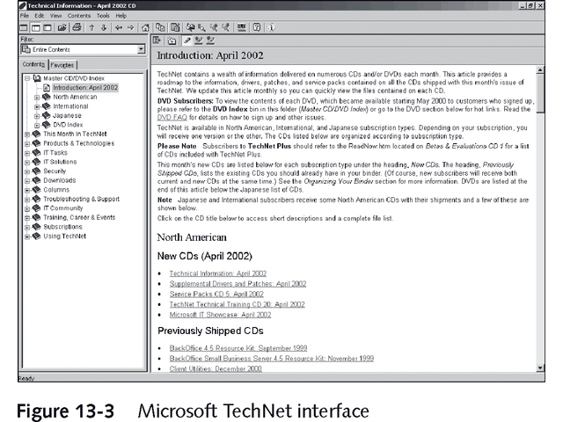
Microsoft TechNet Interface

Slide 42
Microsoft Knowledge Base
Provides information from interaction with customers by technical support staff
Available free on Web or by subscription
See Figure 13-4

Slide 43
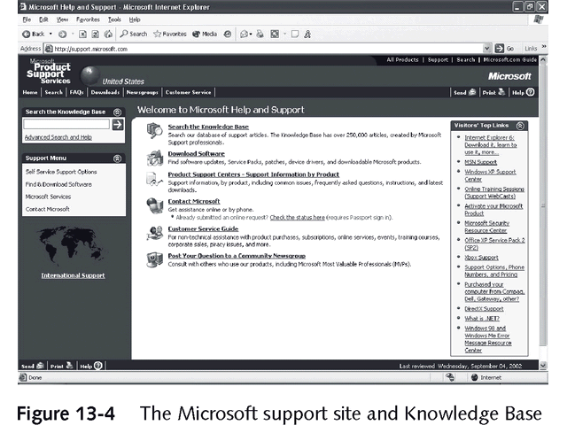
Microsoft Support Site and Knowledge Base

Slide 44
Linux Information Resource
Many Linux resources, including:
www.linux.com - search engine for information, downloads, pointers, and documentation
Everything Linux at www.eunuchs.org - tips, tricks, and troubleshooting techniques
www.linuxcare.com - good source for training, technical information, and for-a-fee technical support

Slide 45
Novell NetWare Information Sources
http://support.novell.com - searchable knowledge base
Provides articles and notices about known problems, bug fixes, workarounds and patches
Contains driver updates and operating system service patches

Slide 46
Online Support Services and Newsgroups
Many online support services, including:
Microsoft Developer’s Network (MSDN) at http://msdn.microsoft.com
Other Microsoft newsgroups at msnnews.microsoft.com
www.sunbelt-software.com - Windows mailing list

Slide 47
Periodicals
Many deal specifically with computers and networking and are available over Internet or offer free subscriptions
Most popular journals include:

Slide 48
Periodicals
Many deal specifically with computers and networking and are available over Internet or offer free subscriptions
Most popular journals include:
LAN Magazine
LAN Times
Communications Week
InfoWorld
eWeek
PC Magazine (Network Edition)
Network Computing

Slide 49
Common Troubleshooting Situations
Some of most common network problems involve:
Cabling and related components
Power fluctuations
Upgrades
Poor network performance

Slide 50
Cabling and Related Components
Majority of network problems occur at Physical layer and involve cables, connectors, and NICs
Make sure cable is properly connected and correct kind
Be sure length is within maximum limit for type of medium
Check LEDs on NIC, if available
Exchange NIC with known working one
Use PING utility to check connectivity to other computers

Slide 51
Power Fluctuations
Caused by electrical storm or power failure
Adversely affect computers
Afterwards, verify that servers are up and functioning
Use Uninterruptible Power Supplies (UPSs)
Especially important for servers
Provide battery power so computers can be brought down without data loss
Some perform automatic shutdowns

Slide 52
Upgrades
Constantly changing technology makes it necessary to upgrade equipment and software frequently
Some important considerations when performing network upgrades:
Keep current and do one upgrade at a time
Ignoring upgrades may require complete network overhaul
Test any upgrade before deploying it
Inform users about upgrade: when it will occur, what is involved, and what to expect

Slide 53
Poor Network Performance
If network slows over time, ask these questions to pinpoint causes:
What has changed?
Have new equipment or applications been added?
Is someone playing electronic games across network?
Are there new users on network? How many?
Is other new equipment, such as a generator, causing interference near network?
May be necessary to expand network to increase current capacity

Slide 54
Chapter Summary
Network-management, planning, and monitoring are critical parts of network administrator’s job
Proper management can avoid or minimize potential problems
Avoiding problems is better than solving problems
Key to pre-emptive troubleshooting is to understand and apply OSI network-management model, consisting of accounting, configuration, performance and security management

Slide 55
Chapter Summary
Planning is key part of network management
Planning includes setting back-up schedules and guidelines, security guidelines, hardware and software standards, and upgrade guidelines
Create written plans, policies, and procedures
Maintain a complete set of network documentation

Slide 56
Chapter Summary
Documentation should include network map, cable map, equipment list, server configuration, software configuration, address list, user administration, software licensing, contact list, network hardware configuration, network history, and comprehensive list of policies and procedures
Many programs are available to assist with network management and monitoring

Slide 57
Chapter Summary
Using tools to monitor your network, you can establish a network performance baseline against which to identify anomalies
Performance Monitor in Windows NT and Windows 2000 is valuable tool for establishing baseline and tracking network performance
SNMP is specialized TCP/IP protocol for network monitoring and management
SNMP can manage and monitor most network devices

Slide 58
Chapter Summary
RMON software probes provide detailed network and application information
RMON1 works at Data Link and Physical layers
RMON2 analyzes data from Network layer to Application layer
When an error occurs, use structured, methodical approach to troubleshooting eases tension and ensures that all possible solutions are covered

Slide 59
Chapter Summary
Many tools and resources help troubleshoot network
Software and Internet resources are available, including Microsoft TechNet, Microsoft Knowledge Base, Novell knowledge base, and Linuxcare.com
Troubleshooting usually falls into one of basic categories of solutions
Common networking troubleshooting scenarios pinpoint many problems

Slide 60
Chapter Summary
For difficult problems, fall back on structured network troubleshooting approach
Change is most common cause of network problems
Try to identify what has changed since change is most common cause of network problems
Common sources of problem-causing changes include adding new equipment or software, upgrading existing software or equipment, and workload or workplace behavior that results in increased traffic or network utilization

